Slide 1
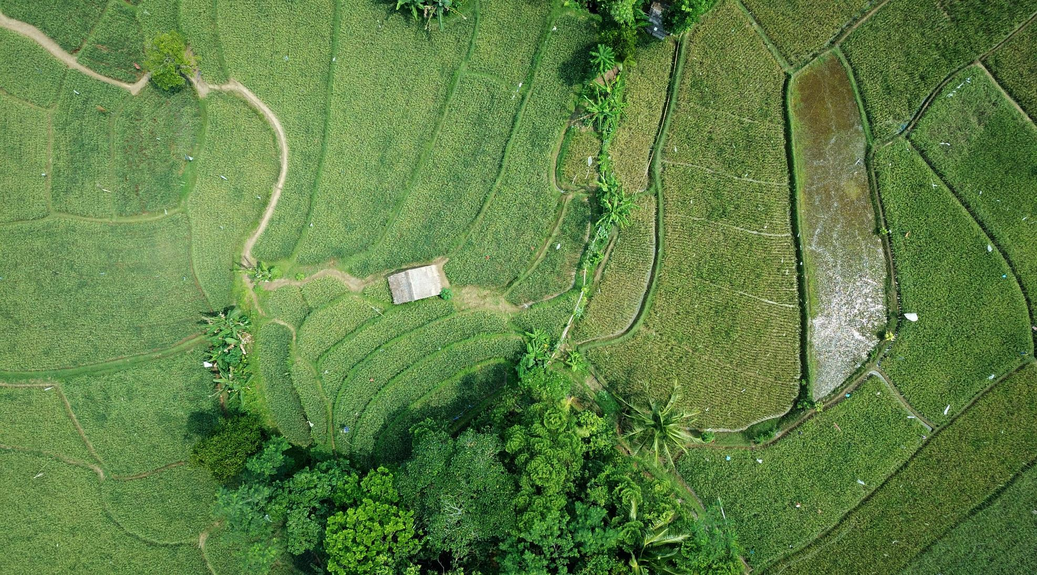
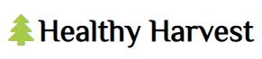
Agriculture Information System
Module Code: ISAD254SL
Module Name: Human Computer Interaction

Slide 2

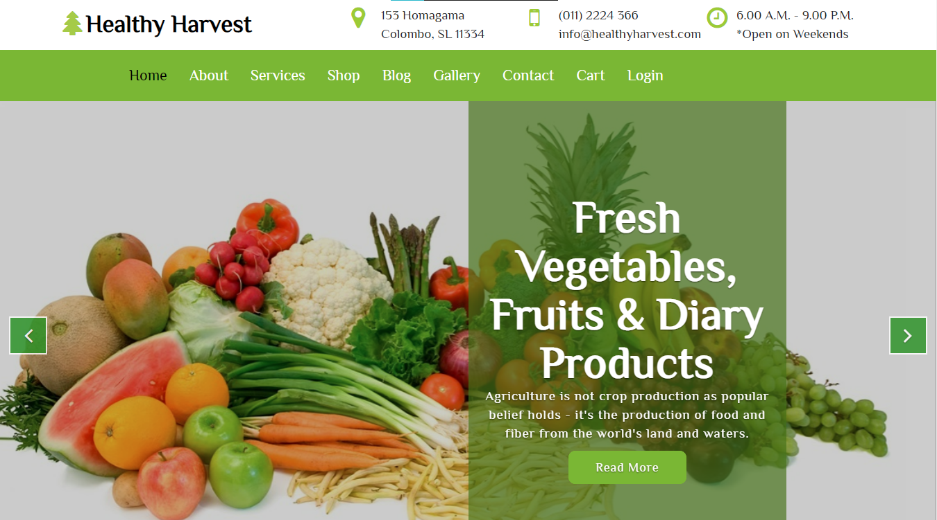
Healthy Harvest Web Application
Introduction
In this project we designed an agricultural information system for a farm named as “Healthy Harvest” which sells organic food items which are grown in the farm itself organically.
Our web application mostly focused on the green concept as we are concerned about the nature.

Slide 3
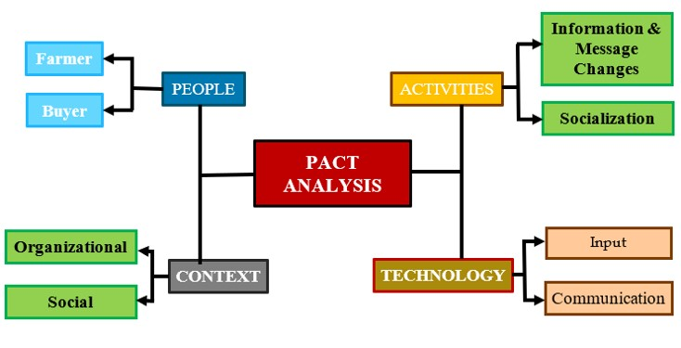
PACT Analysis
A PACT Analysis is a more detailed brief useful framework design, which is used to thinking about human centered design.

Slide 4

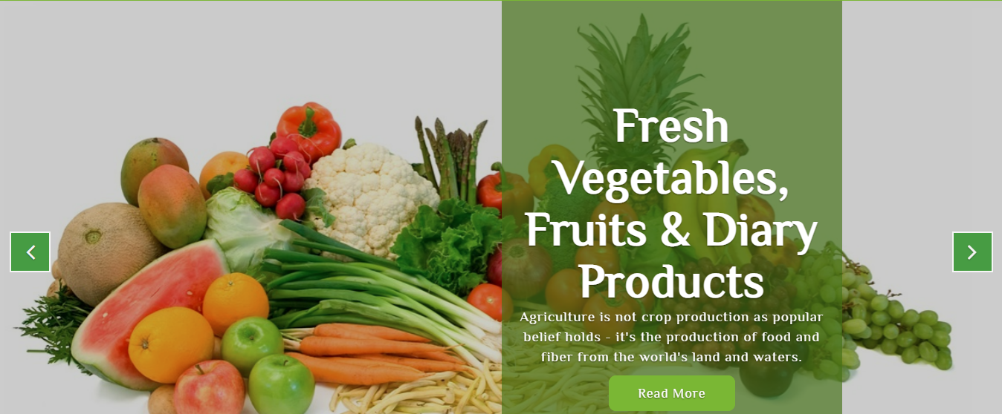
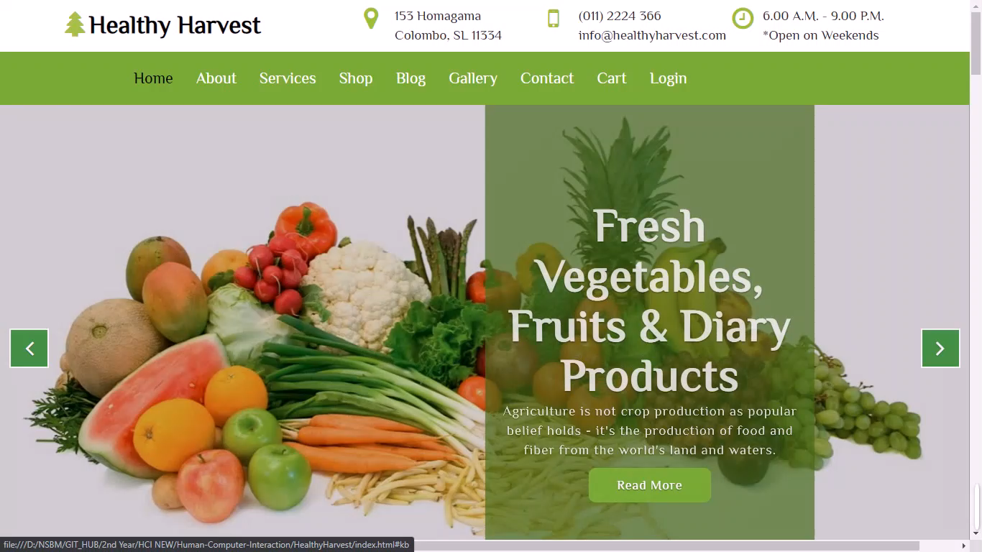
HOME PAGE
This is the “Home Page” in our Healthy Harvest Web application.
When we are creating this application, we used html, CSS, and JavaScript.
HOME PAGE

Slide 5
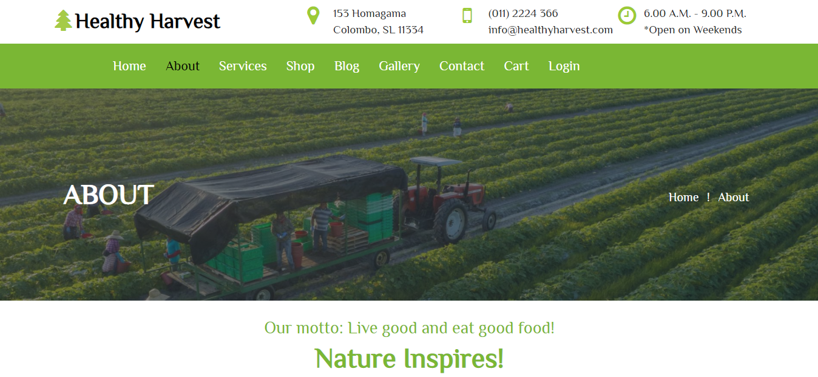
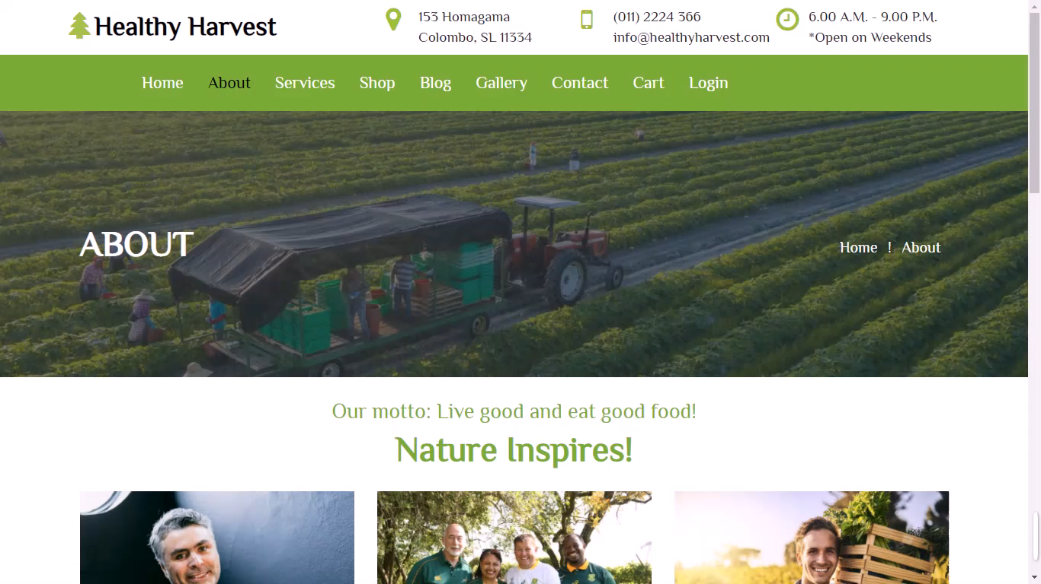
This is the “About Page” in our Healthy Harvest Web application.
When we are creating this application, we used html, CSS, and JavaScript.
ABOUT PAGE

Slide 6
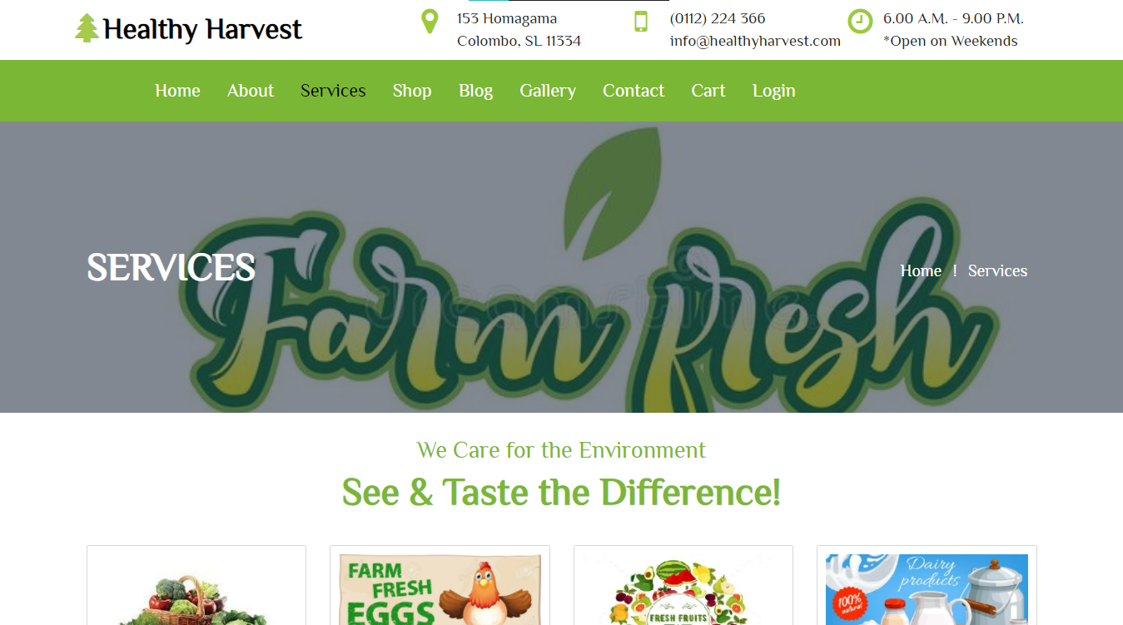
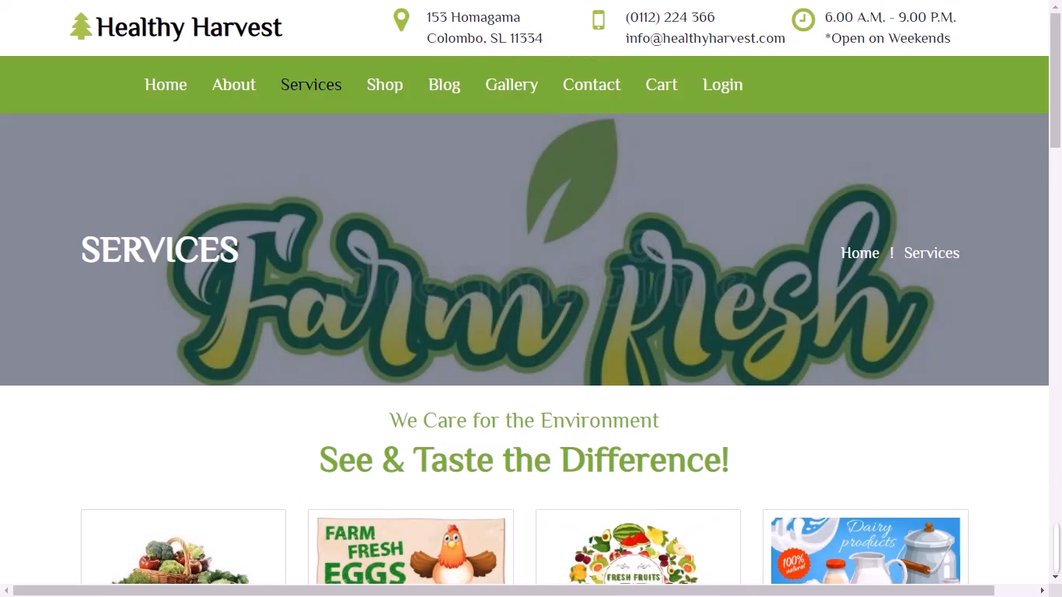
SERVICES PAGE
This is the “Services Page” in our Healthy Harvest Web application.
When we are creating this application, we used html, CSS, and JavaScript.
SERVICES

Slide 7
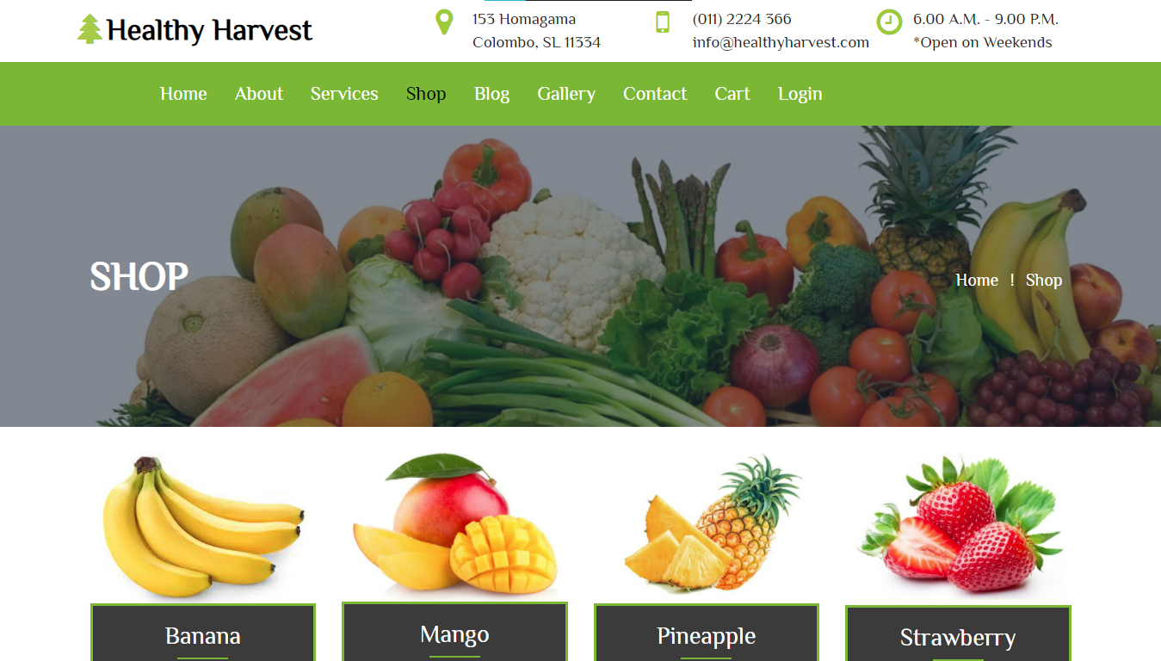
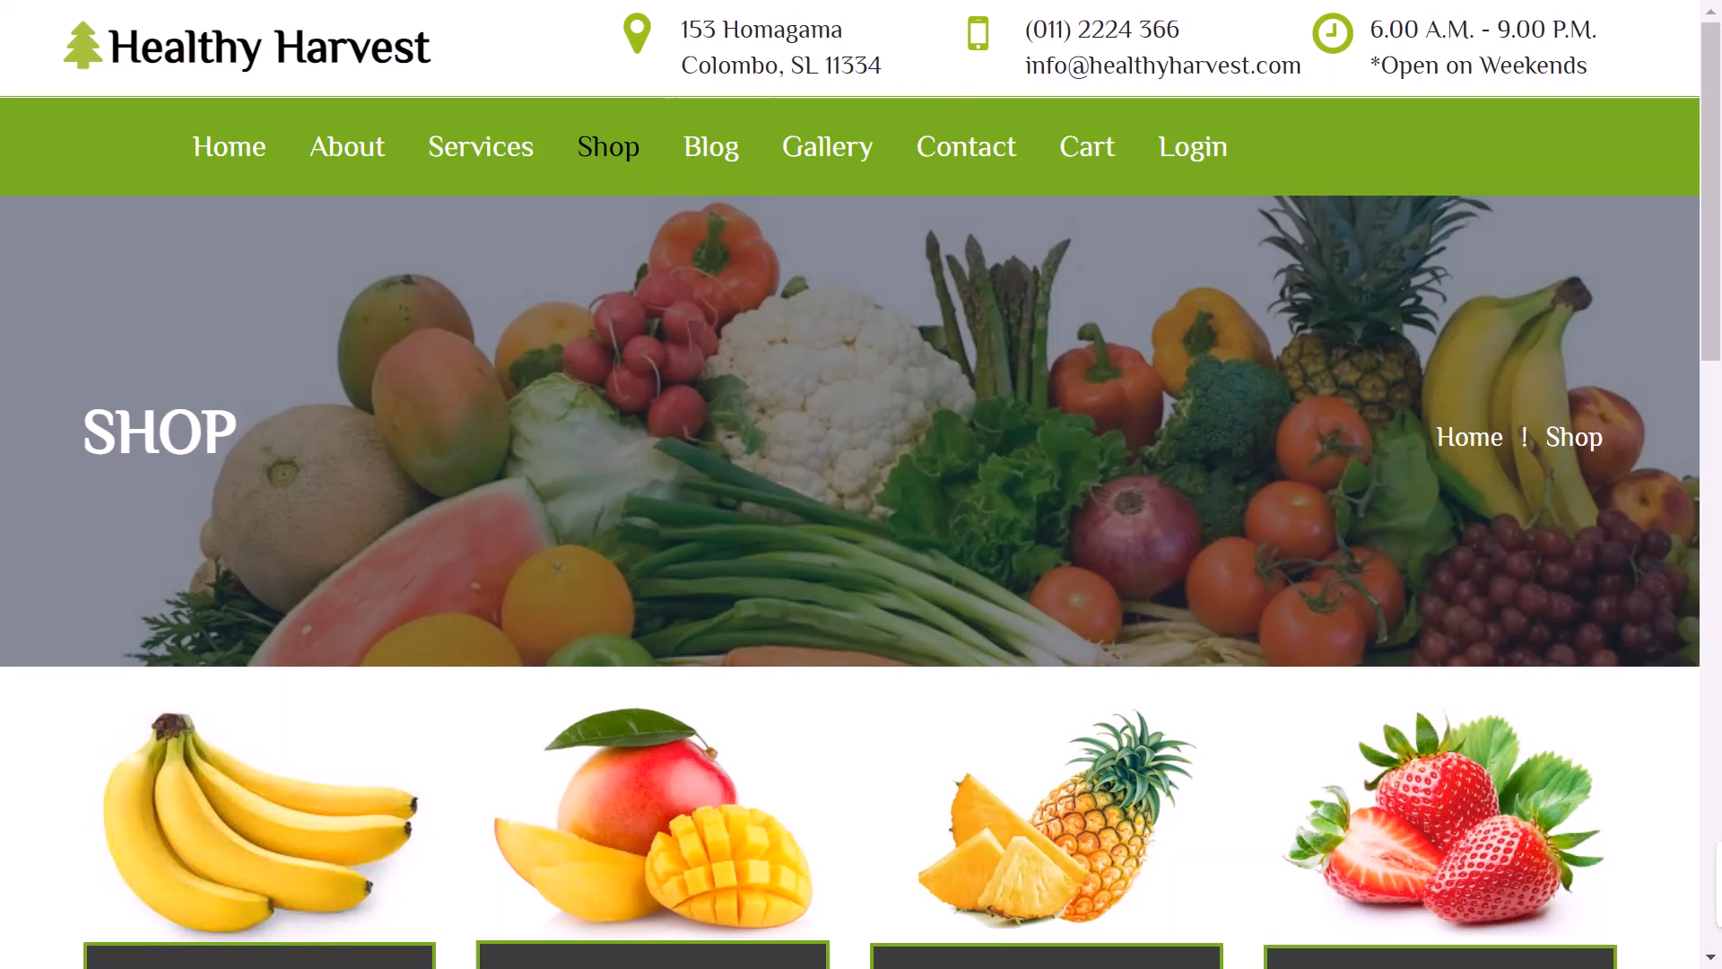
This is the “Shop Page” in our Healthy Harvest Web application.
Clicking on any item, buyer can see more detail & buy these products.
SHOP PAGE
When we are creating this application, we used html, CSS, and JavaScript.

Slide 8
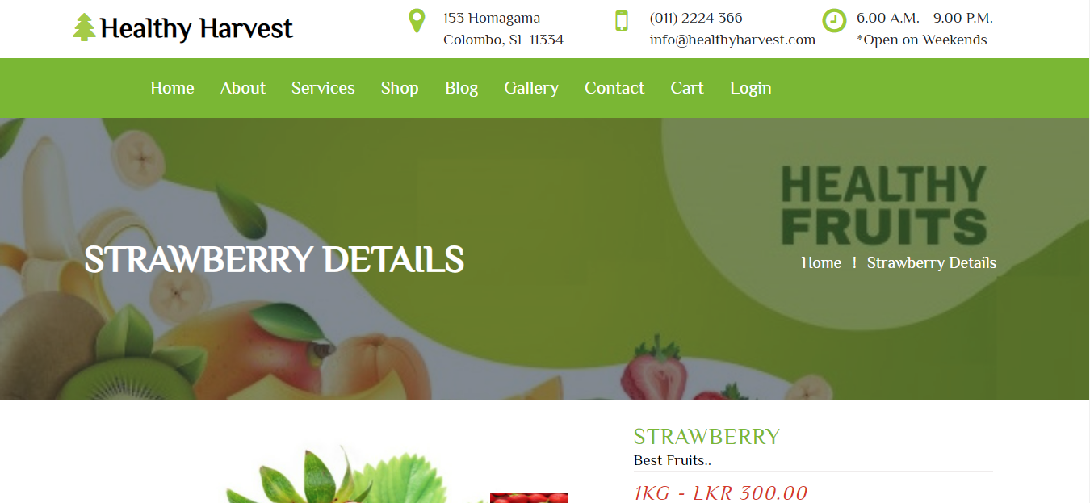
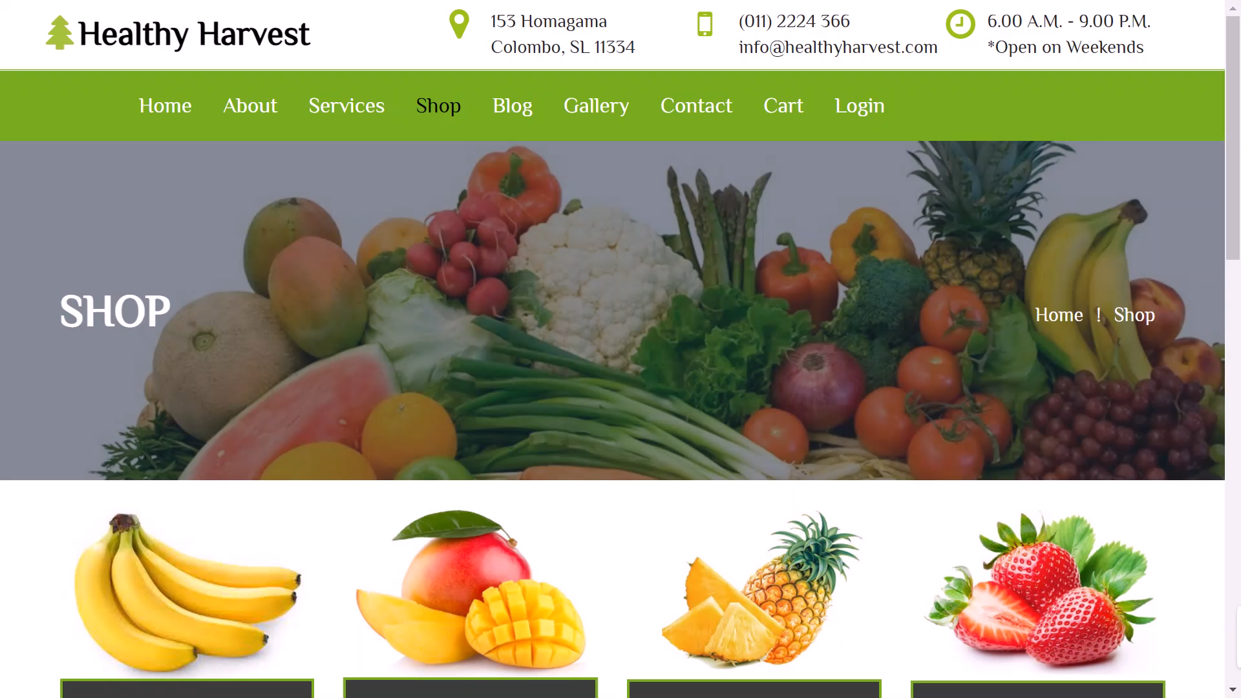
HOME PAGE
This is the “Shop-Details Page” in our Healthy Harvest Web application.
Buyer can choose the weight of an item and these items will be added to the cart and they can contact us using this page.
SHOP-DETAILS PAGE
When we are creating this application, we used html, CSS, and JavaScript.

Slide 9
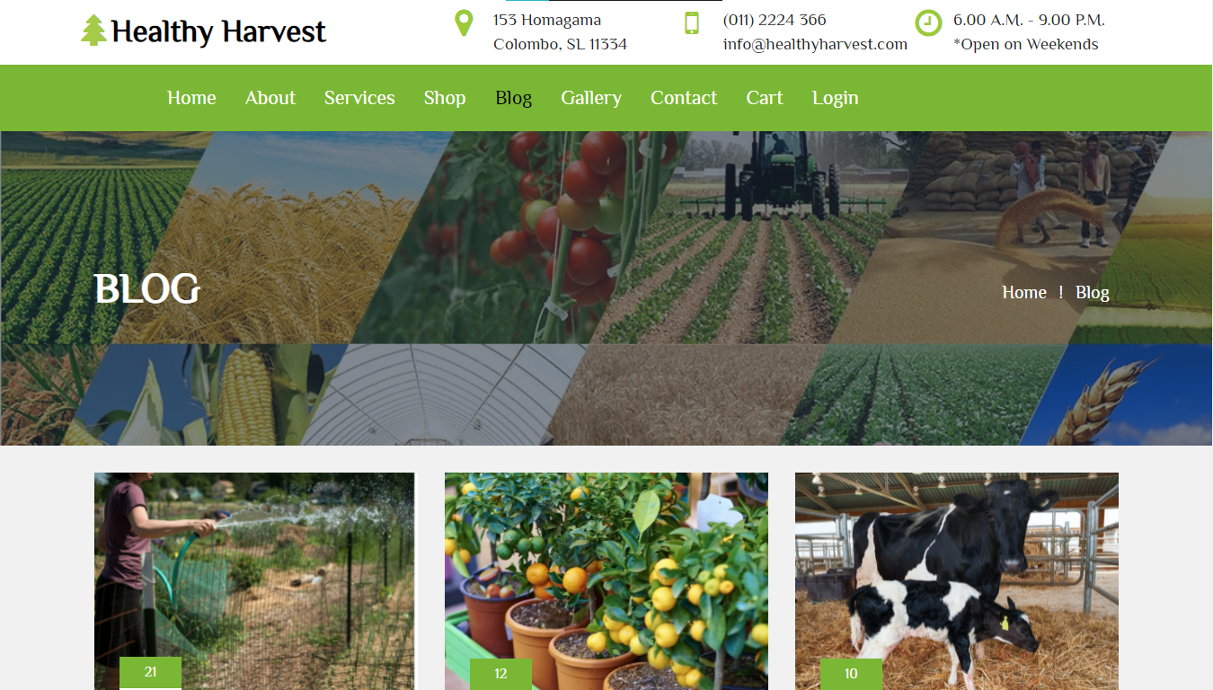
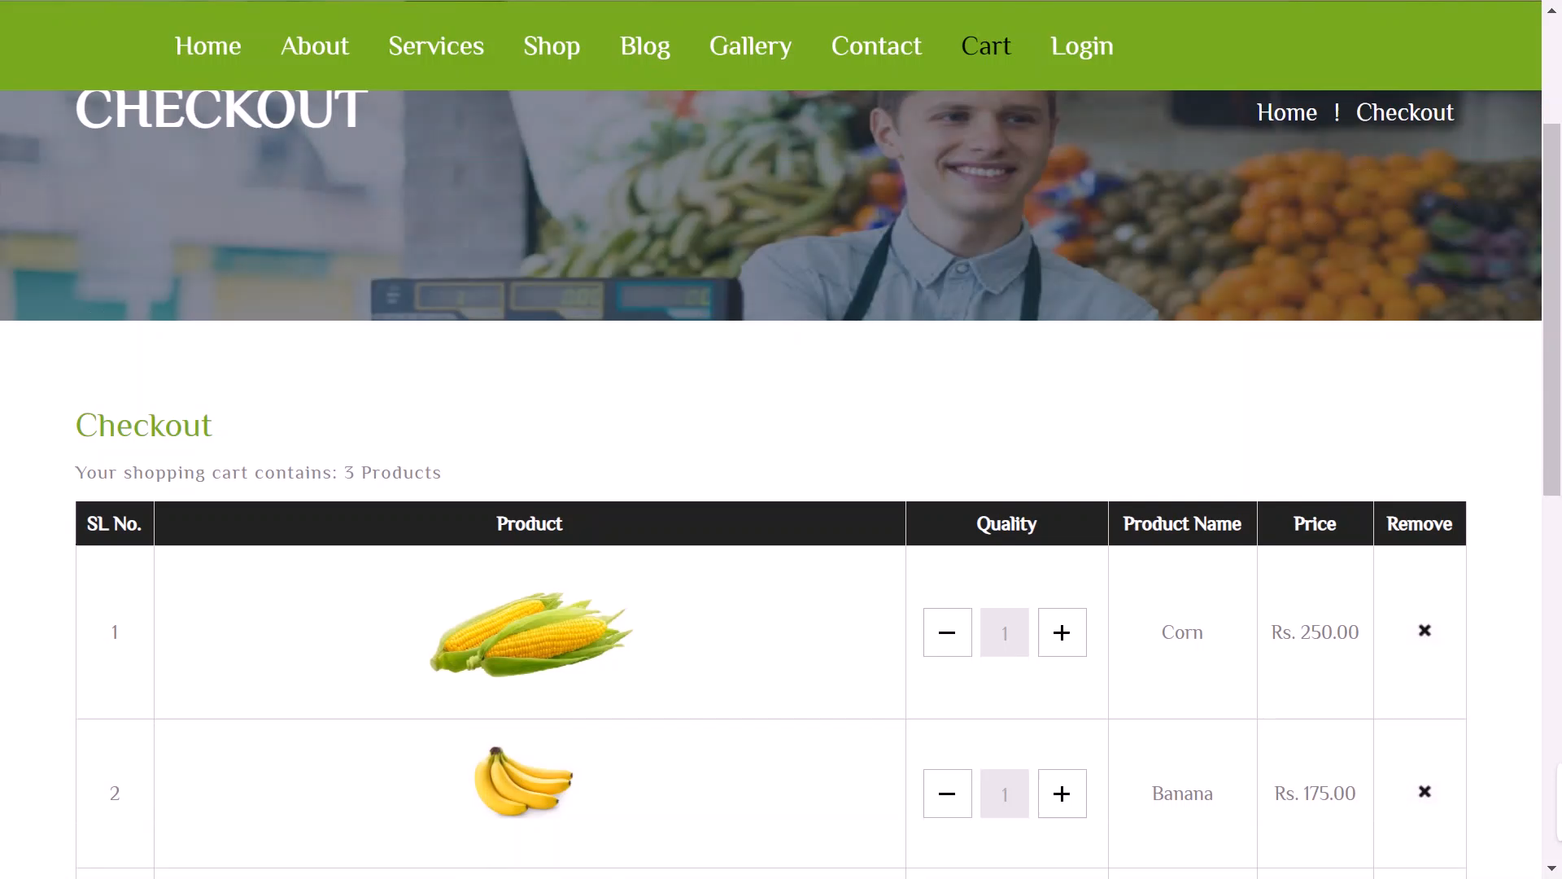
This is the “Cart Page” in our Healthy Harvest Web application.
When we are creating this application, we used html, CSS, and JavaScript.
CART PAGE

Slide 10
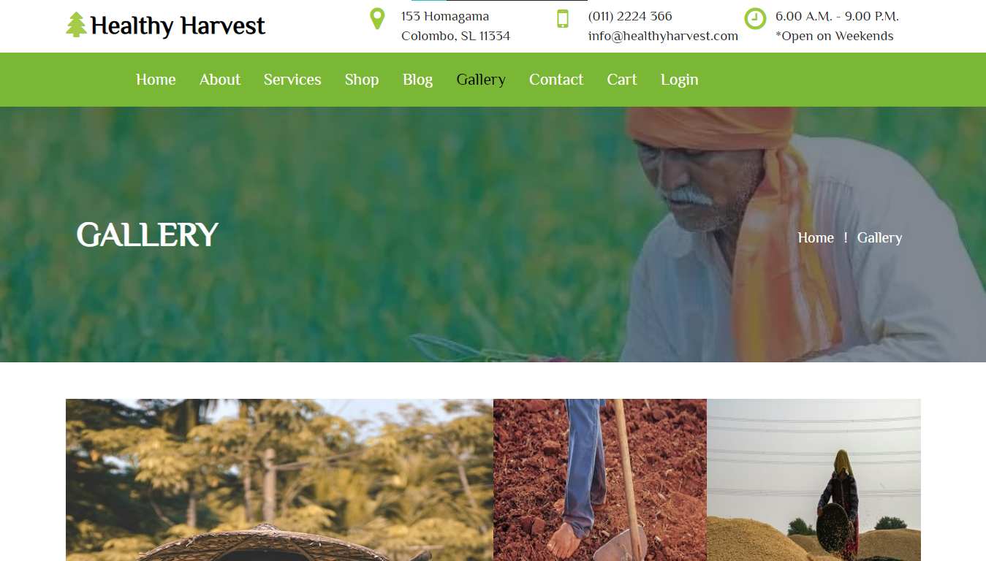
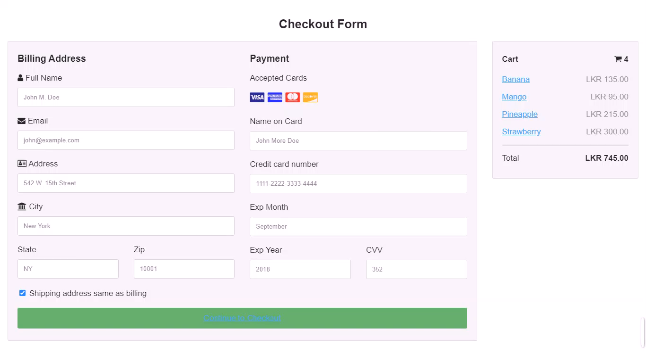
This is the “Billing Details Page” in our Healthy Harvest Web application.
When we are creating this application, we used html, CSS, and JavaScript.
BILLING DETAILS PAGE

Slide 11
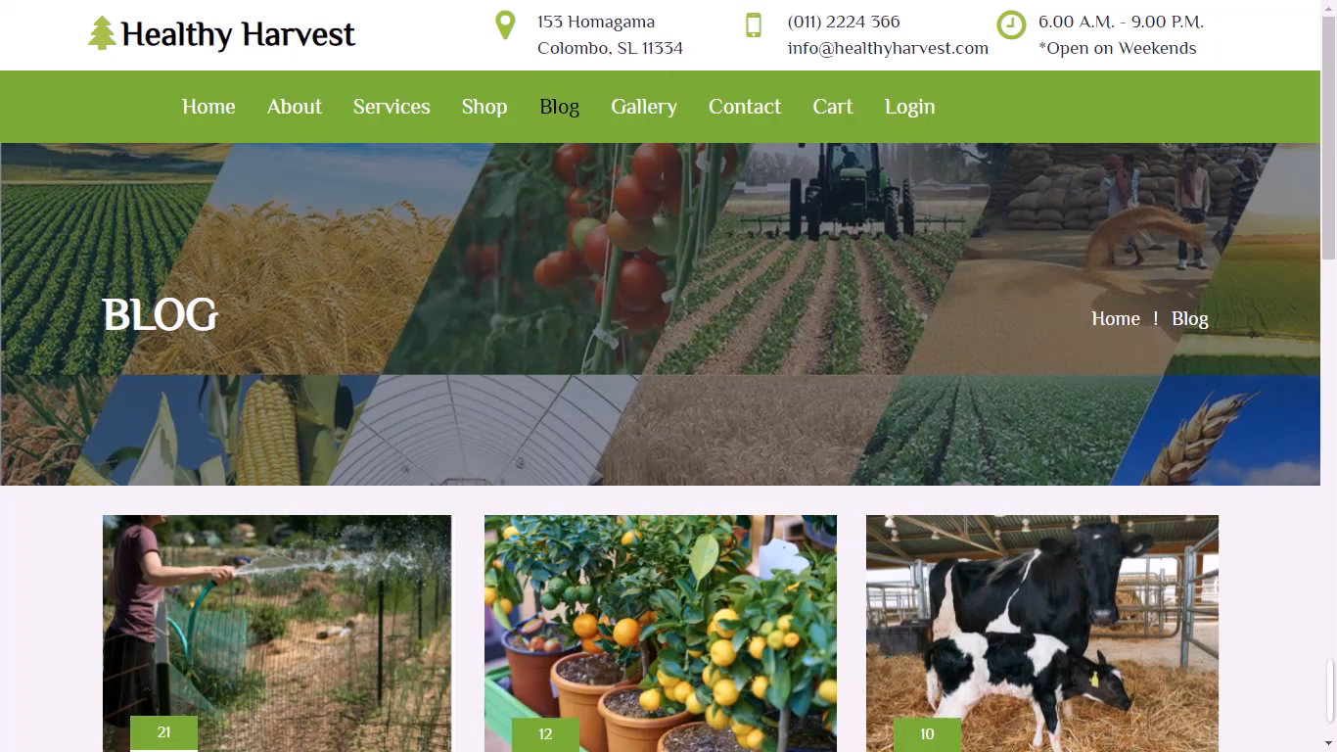
This is the “Blog Page” in our Healthy Harvest Web application.
When we are creating this application, we used html, CSS, and JavaScript.
BLOG PAGE

Slide 12
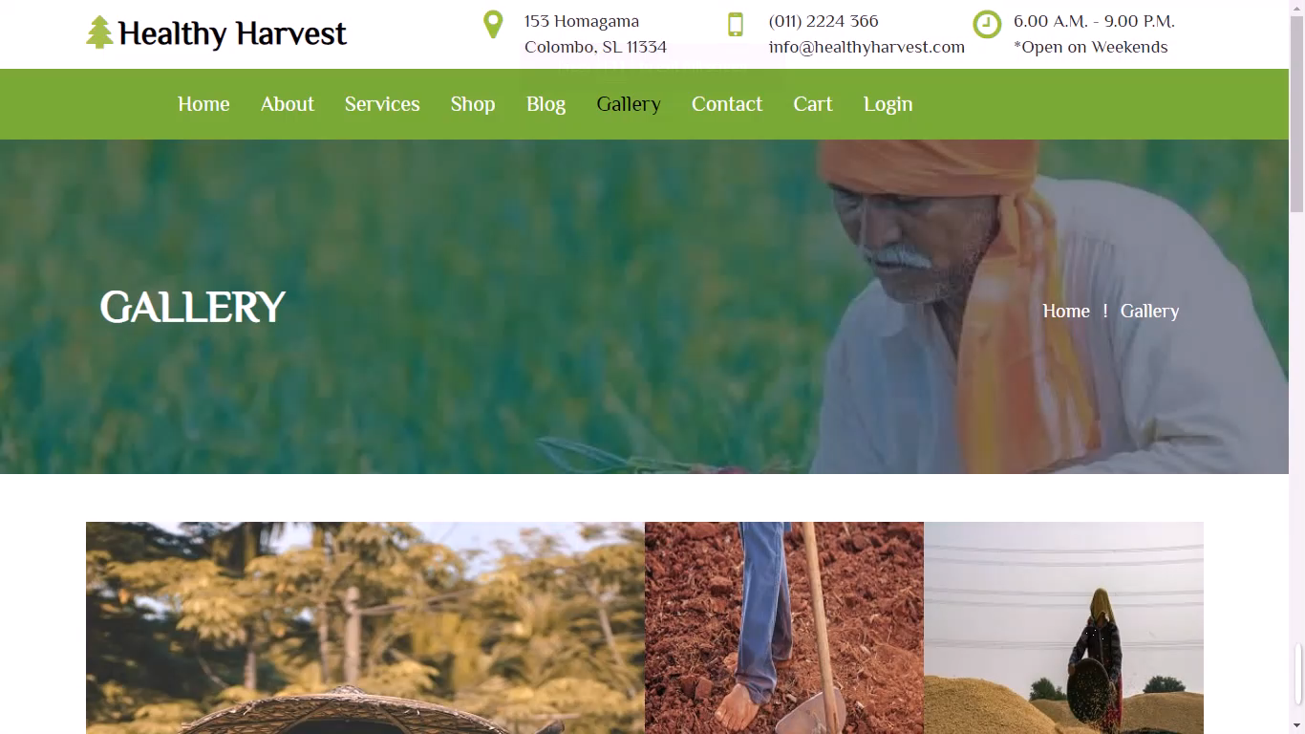
This is the “Gallery Page” in our Healthy Harvest Web application.
When we are creating this application, we used html, CSS, and JavaScript.
GALLERY PAGE

Slide 13
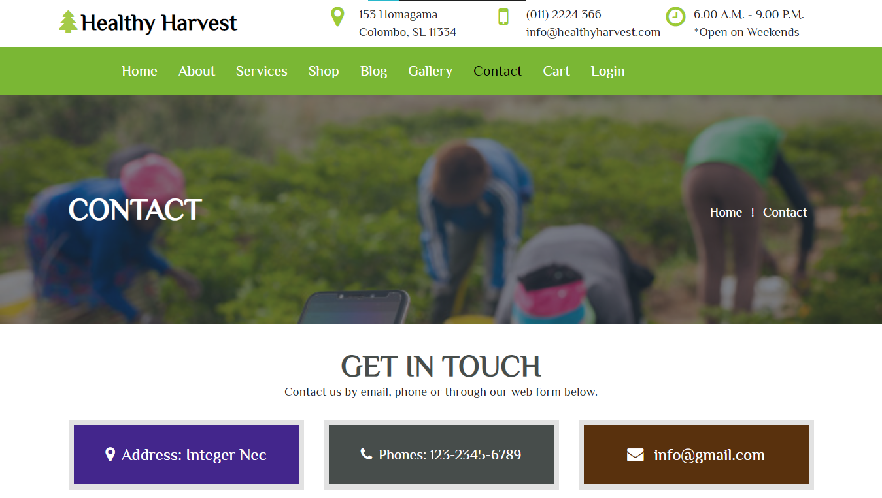
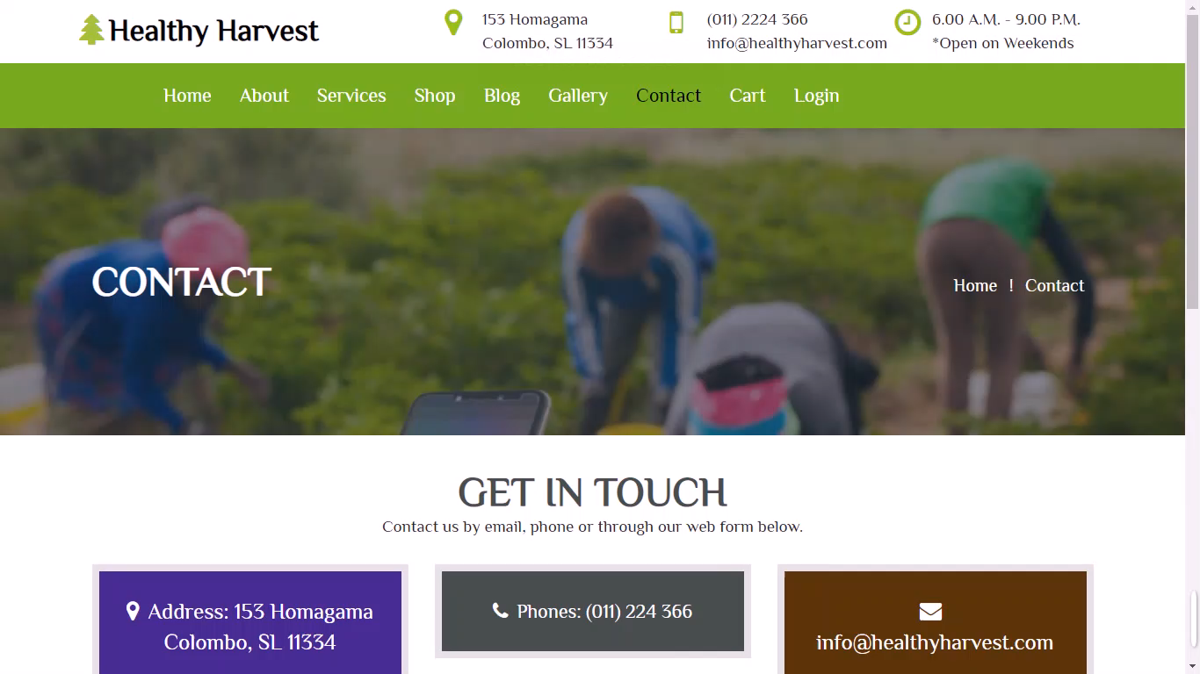
This is the “Contact Page” in our Healthy Harvest Web application.
When we are creating this application, we used html, CSS, and JavaScript.
CONTACT PAGE

Slide 14
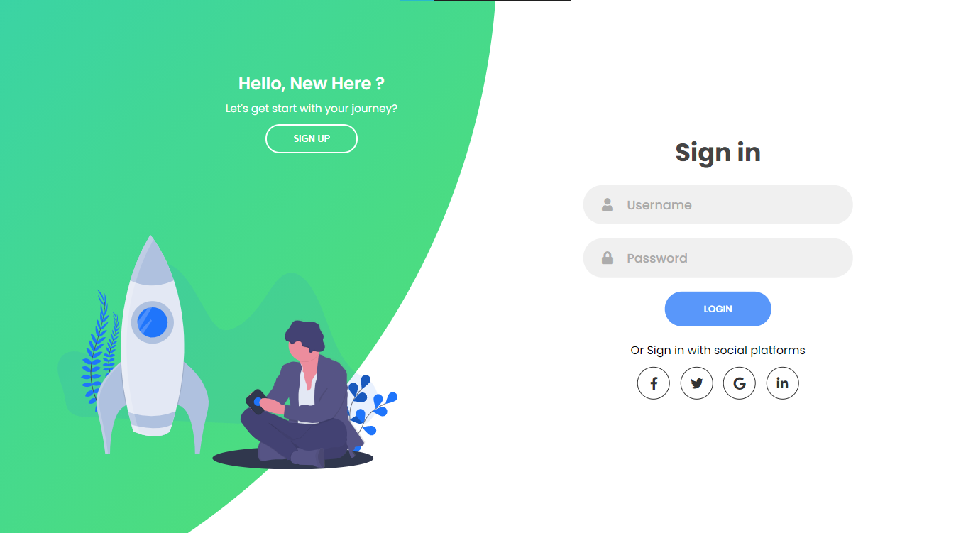
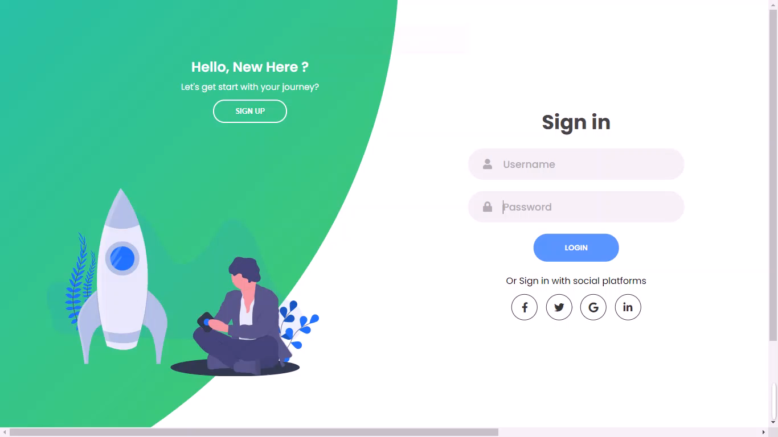
HOME PAGE
This is the “Sign-In Page” in our Healthy Harvest Web application.
When we are creating this application, we used html, CSS, and JavaScript.
SIGN IN PAGE

Slide 15
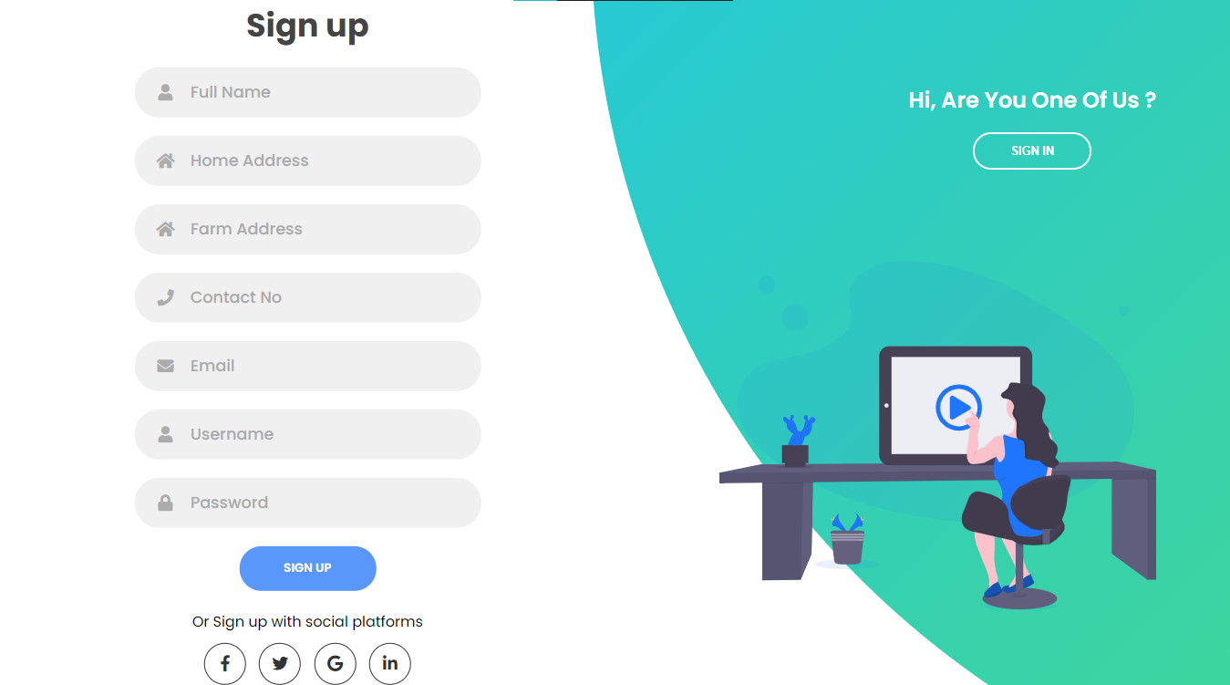
This is the “Sign-Up Page” in our Healthy Harvest Web application.
When we are creating this application, we used html, CSS, and JavaScript.
SIGN-UP PAGE

Slide 16
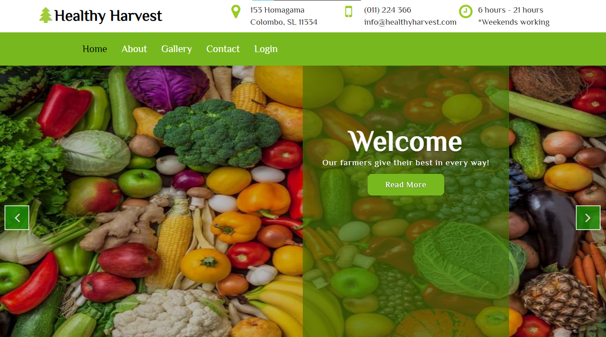
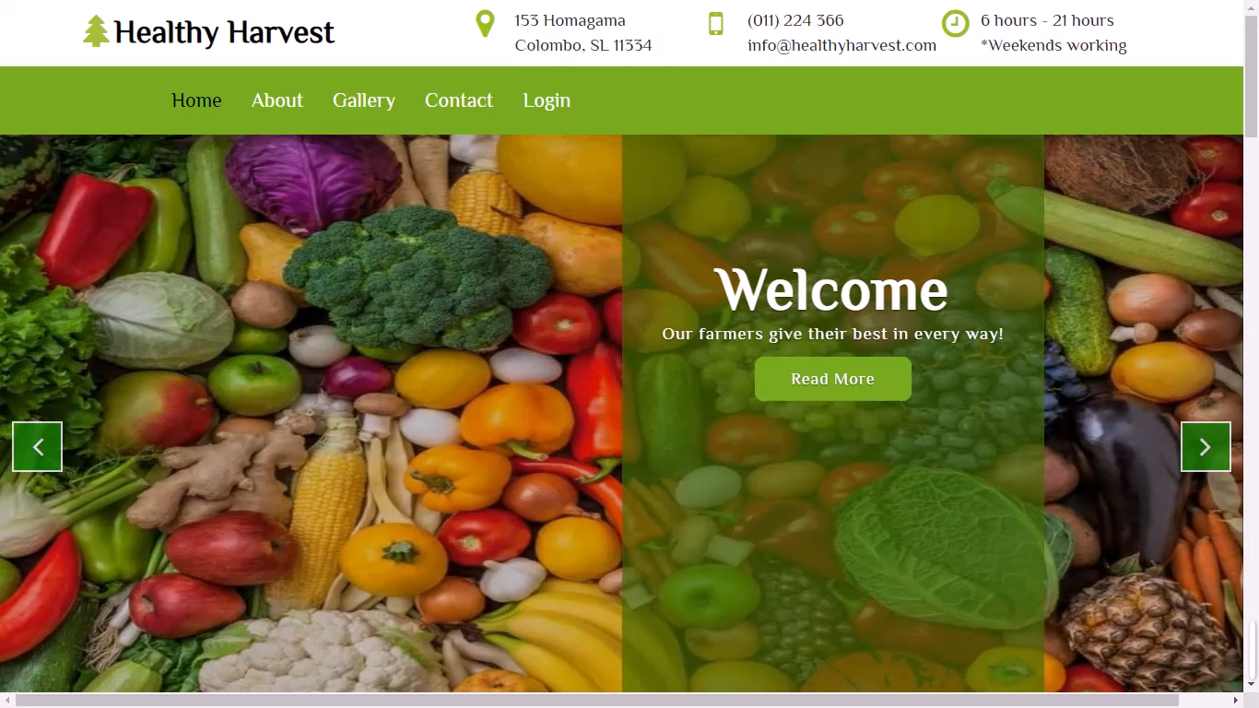
HOME PAGE
This is the “Farmer Home Page” in our Healthy Harvest Web application.
When we are creating this application, we used html, CSS, and JavaScript.
FARMER HOME PAGE

Slide 17
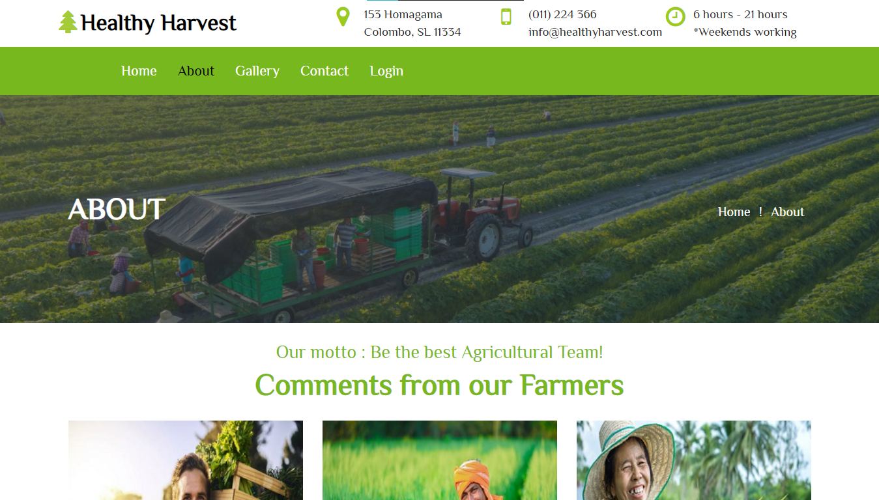
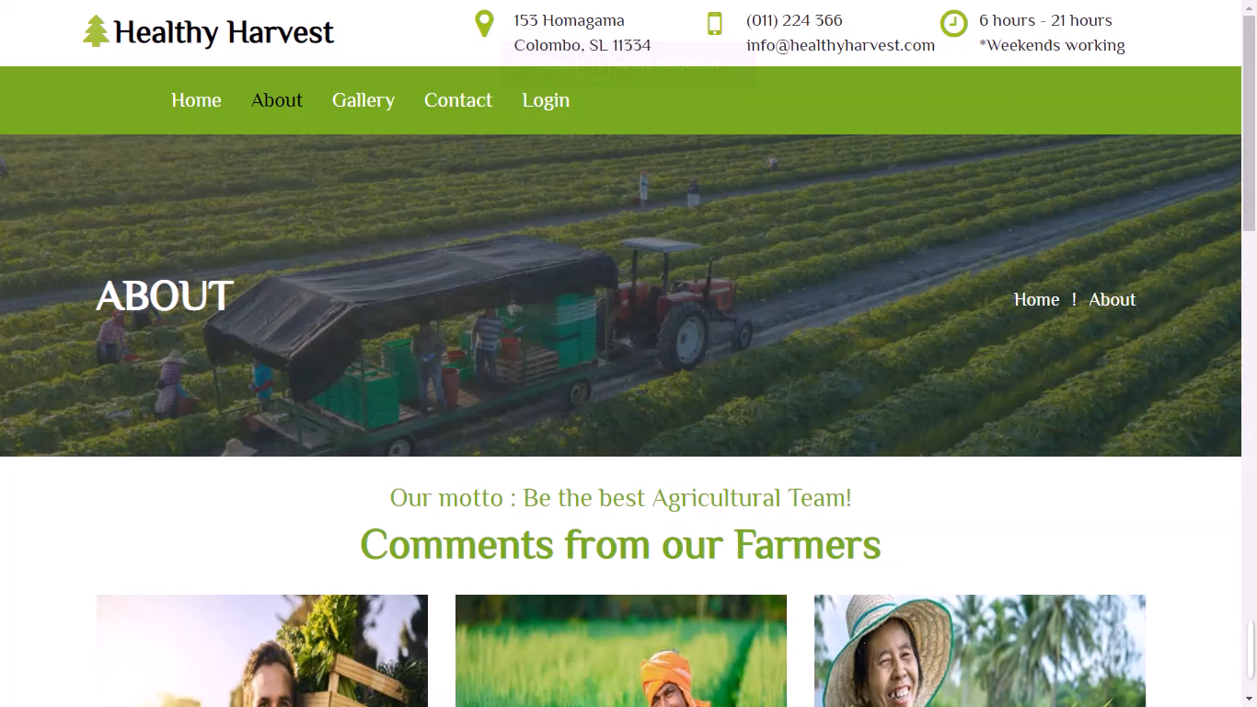
This is the “Farmer About Page” in our Healthy Harvest Web application.
When we are creating this application, we used html, CSS, and JavaScript.
FARMER ABOUT PAGE

Slide 18
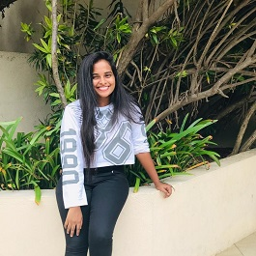
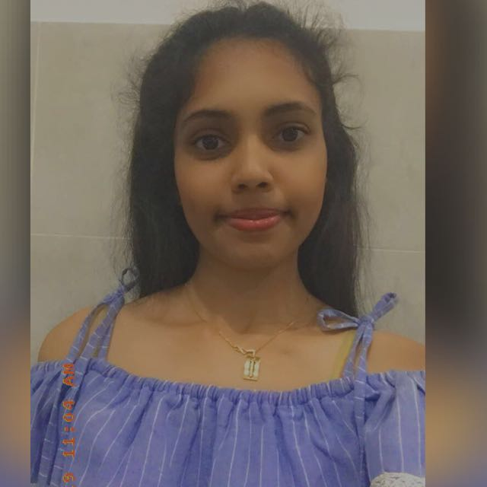
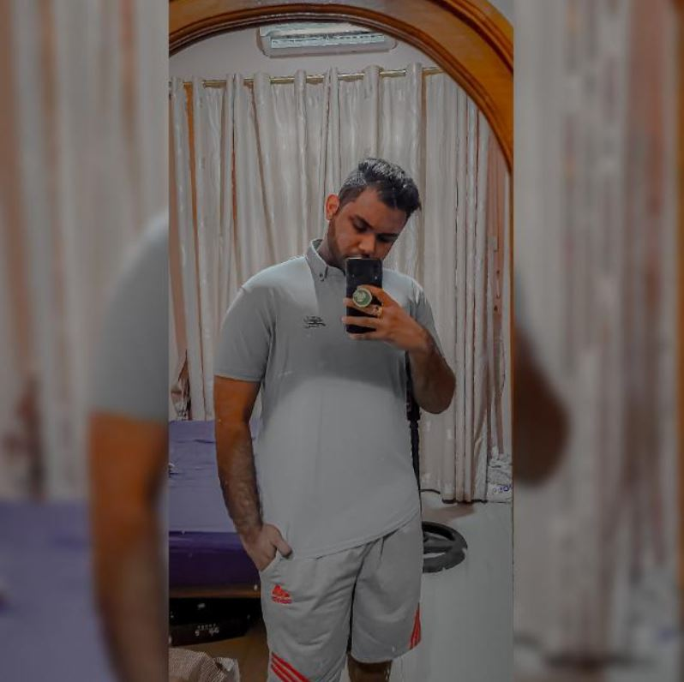
Team - 21
H S Kaushalya
V P N Sulakshika
Victoria Lindqvist
Plymouth ID: 10707241
Plymouth ID: 10707385
Plymouth ID: 10707372
Created:
About, Cart, Farmer’s Home & Farmer’s About pages.
Created:
Home, Services, Shop, Shop-deatils & Blog pages.
Created:
Gallery, Contact, Sign-In & Sign-Up pages.

Slide 19

Summary
Walt Disney is one of the greatest UI/UX designers ever born. His animation skills are so imaginary that everyone loved his animations. This project is related to designing and involves lot of creativity and requires lot of thinking ability like to think what kind of UI’s have to be made, to the target end users are and so on. Here we designed the project for the “Healthy Harvest” an agricultural Information System and we have added some more functions to this application where the user can buy the products and there are separate UI’s where the farmers can communicate with the business when needed.

Slide 20
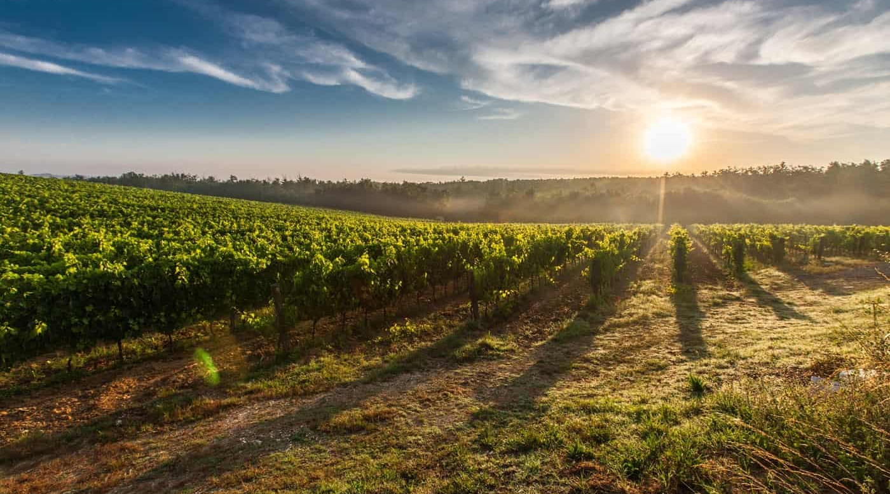
Thank You

